Slide 1

DEPARTMENT OF COMPUTER ENGINEERING
VIDYALANKAR INSTITUTE OF TECHNOLOGY, MUMBAI
UNIVERSITY OF MUMBAI
Academic Year 2019-20
A
Presentation
on
“Updating Gen-Z”
By
Under the Guidance of
Prof. Mohini Chaudhari
Deep Shahane | 19102B0052
Riya Ingale | 19102B0030
Samiksha Pansare | 19102B0021
Rutvik Narkar | 19102B0060

Slide 2
Contents
Introduction
Problem Statement
Motivation
Proposed System
Features
Conclusion & Future work
References

Slide 3
INTRODUCTION
An individual’s personality can be judged by his up-to-date general knowledge of various subjects and current affairs in different domains that makes him an intelligent person with whom everyone would like to interact and would also like to ask him for some advice. From students to professionals to business owners to homemakers to retirees, this applies to virtually everyone in all walks of life.
Add more

Slide 4
PROBLEM STATEMENT
What adds the true value to the learning is exposure and experience of different pieces of general knowledge.
Learning is about experiencing and understanding what goes around you from a rational perspective. For the best retention, learning should be in such a way that it is interesting, fun and simple.
The young generation needs to be familiar with the physical real world.

Slide 5
MOTIVATION
General knowledge is something that really helps us to grow both on personal as well as academic level.
General knowledge opens gateways our thinking, and take it to a level from where the whole world seems to be a better place.
It is an unpredictable world and we all need to stay aware and vigilant. An individual who is well aware with current affairs and facts about the world is called an intellectual.
With this motivation of helping the world we decided to develop an application to provide this general knowledge in a fun and effective way.

Slide 6
PROPOSED SYSTEM
We developed this system (i.e., Student Repository) using HTML, CSS, JavaScript, bootstrap in the frontend and FLASK which is a Python based Web-Framework in the backend.
In our System, Student can Add, Update, Delete its Information in an organized manner. To store the student’s data, we used SQLite Database. To manage the Database we used, SQLAlchemy
We developed the Login System for the Students using Flask-Login which is an extension which provide user session management for Flask.
Students are allotted to either of the three mentors and then mentors can view, edit or delete student’s details. These Mentors can search for the students who are registered to them and can easily view and Authenticate their Documents.

Slide 7
ARCHITECTURE

Slide 8
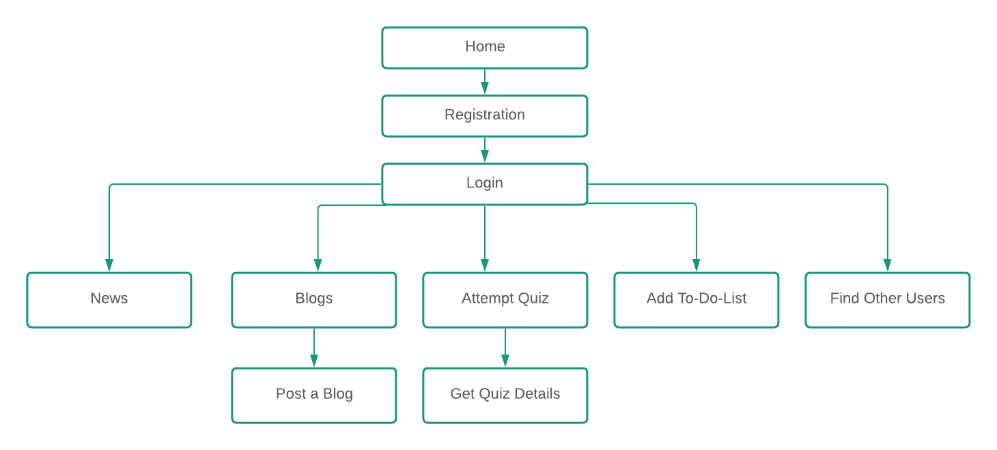
USER FLOW

Slide 9
FEATURES
Latest News
Our Application is targeted towards creating awareness among such young generation a.k.a GEN Z. We provide top stories and news going around the world within the last 24 hrs. at a single click.
Quizzes
One tool becoming more common, especially in online education, is quizzes. Our application aims to provide the knowledge through quizzes. Any questions you answer incorrectly, immediately show you where your knowledge is lacking.
Blogs
New conversations and opportunities can arise just from that gesture, offering even more opportunities to grow. We have a space in our application to write and post your blogs to the world and also read what also be able to read what the world has posted and gain real time knowledge.
To-Do-List
Our application provide you a feature of maintaining To-Do-Lists. When you use them effectively, you'll be much better organized, and you'll be much more reliable.

Slide 10
CONCLUSION & FUTURE WORK
Conclusion of the project is to provide modern education to the young generation by keeping them updated about the current affairs and making it fun with the help of Q&A approach.
Some Future Work on the application could be
Real time mock tests with other users.
Providing with e-books.
Arranging webinars with industry experts.

Slide 11
REFERENCES

Slide 12
THANK YOU!

